Slide 1
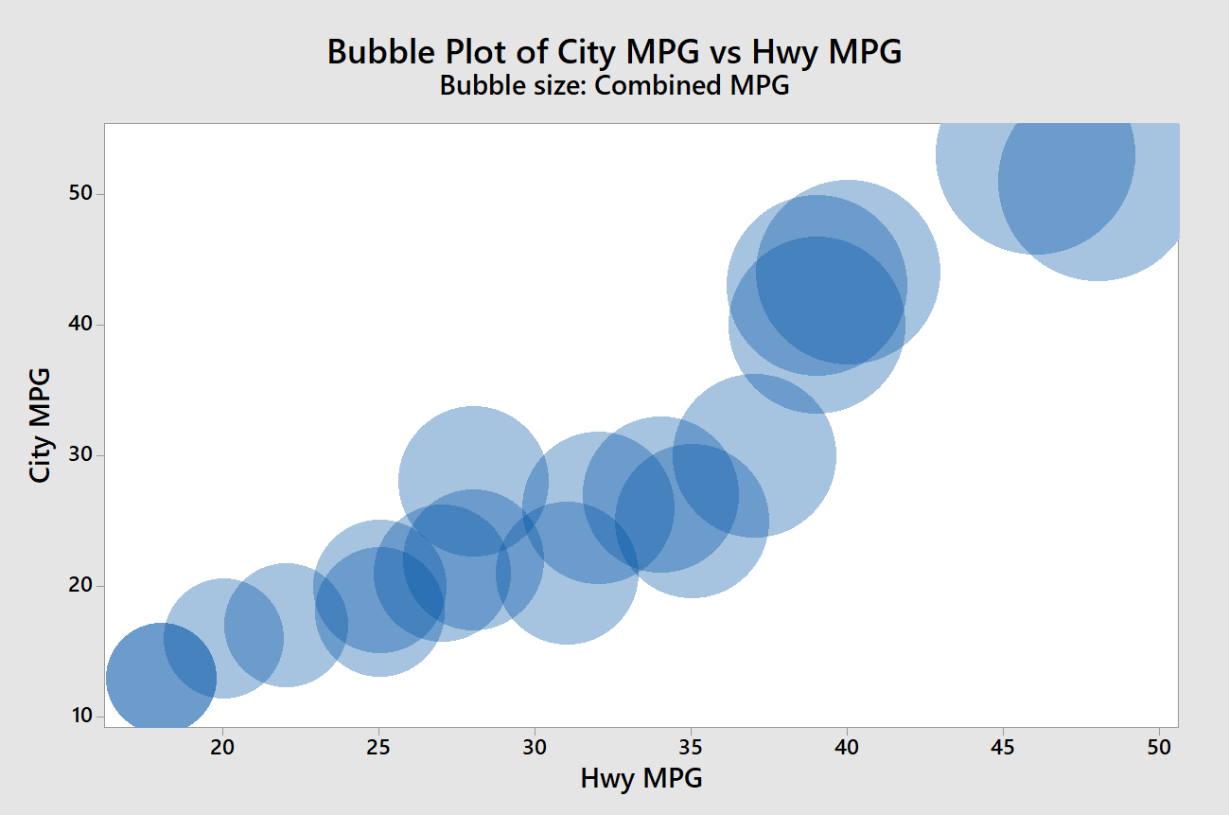
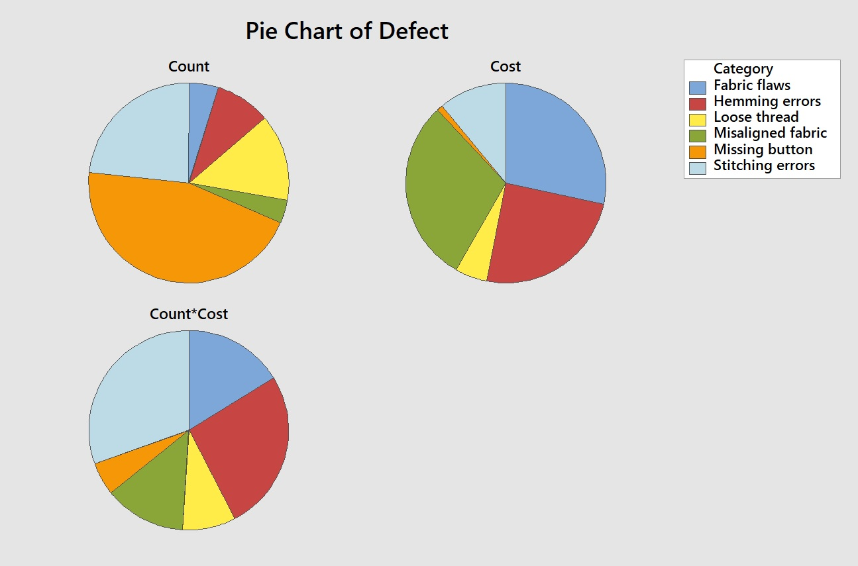
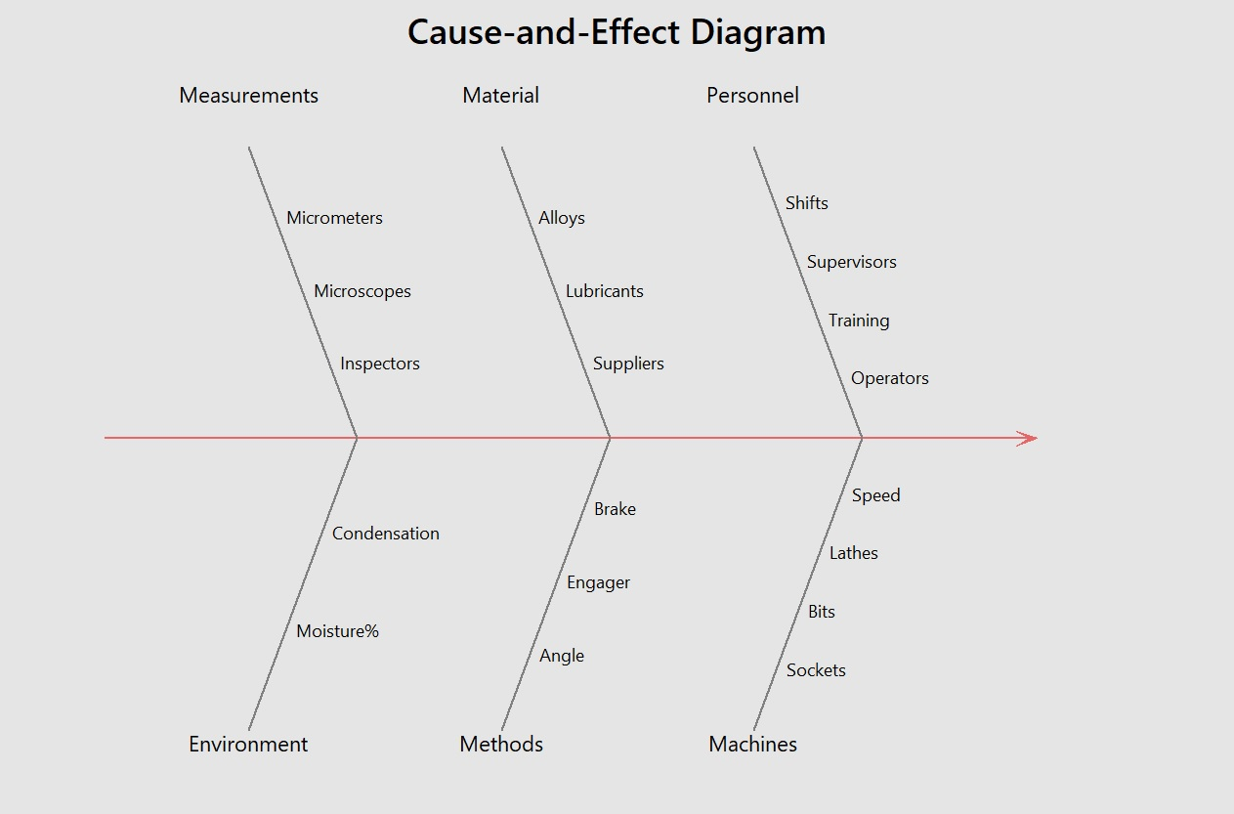
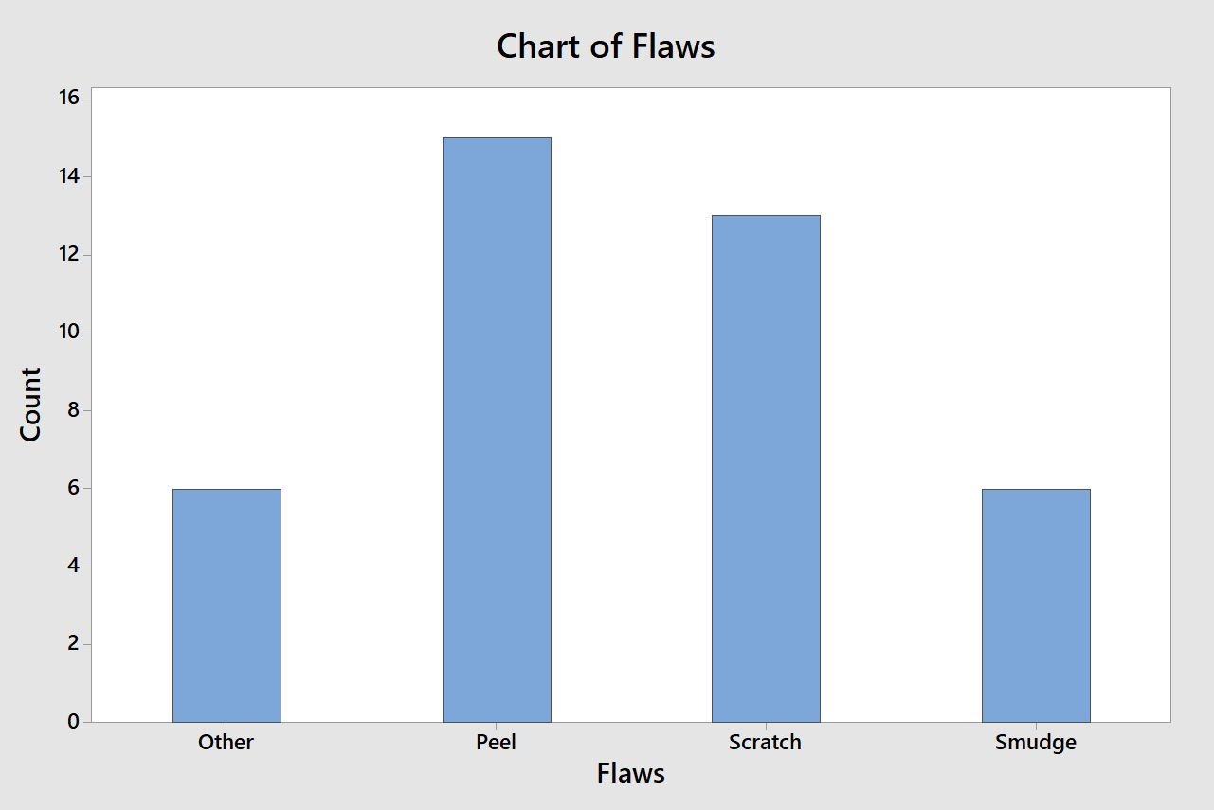
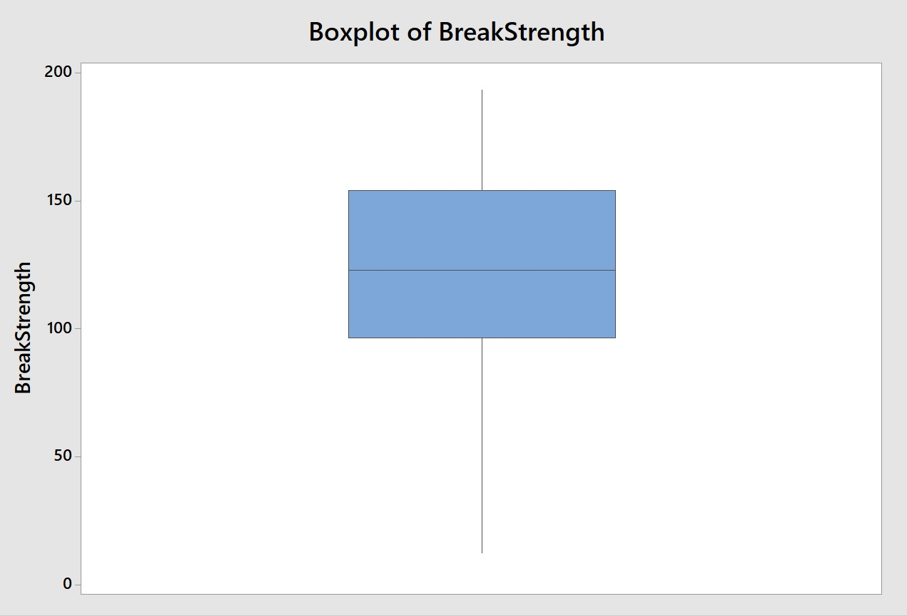
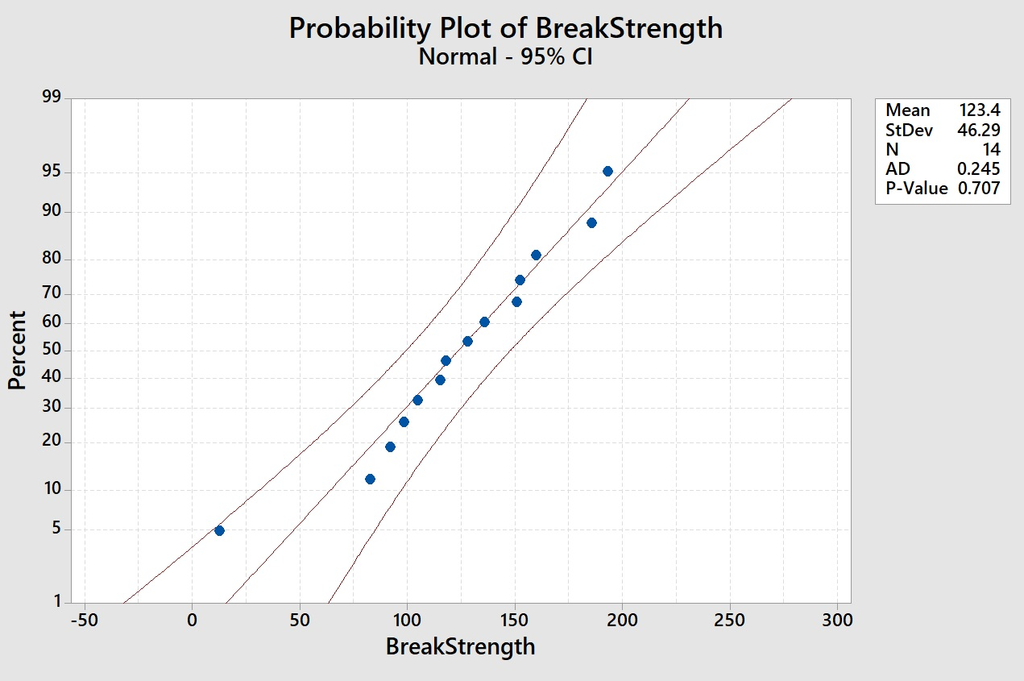
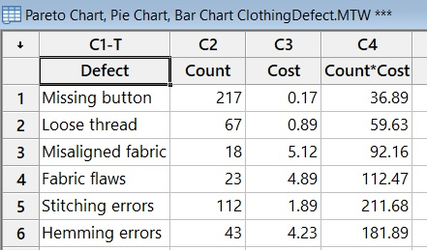
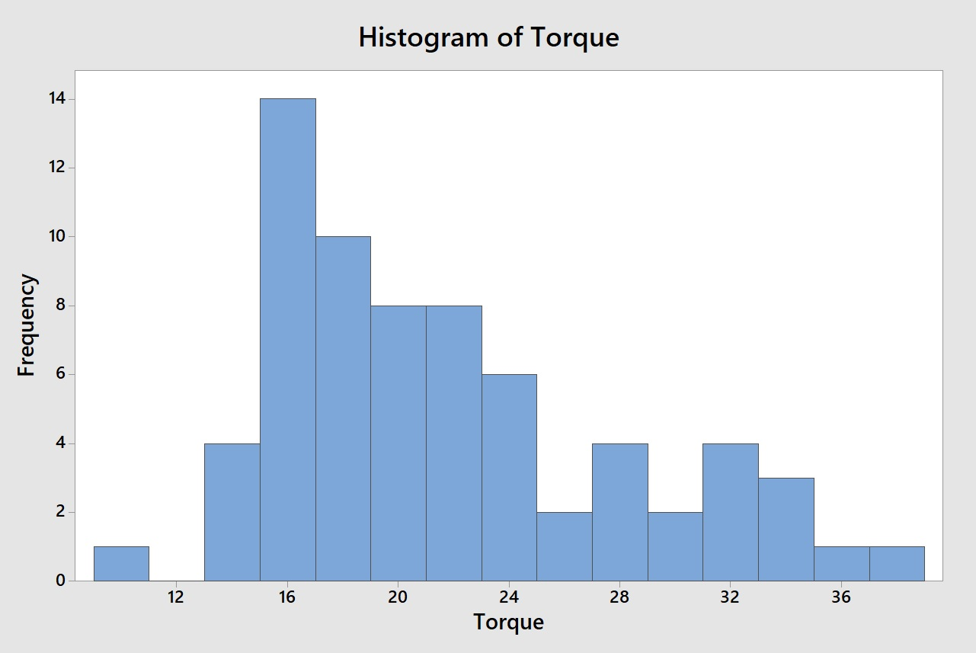
Explanatory Data Analysis Using MINITAB
Name: Mohd. Albab Amin
Roll: 201636007
The following functions were used here:
Stat -use this menu to analyze data. This key menu performs many useful statistical functions
Regression submenu: MINITAB has a Regression submenu in Stat to perform the analyses.
Graph -use this menu to graphically represent the data.
Editor -use this menu to edit and format thedata.
Some Other features are quality tools, control chart etc. submenu under stat menu .
Bubble Plot
Pie Chart
Cause & Effect
Bar Chart
Box Plot
Probability Plot
Histogram

